Slide 1
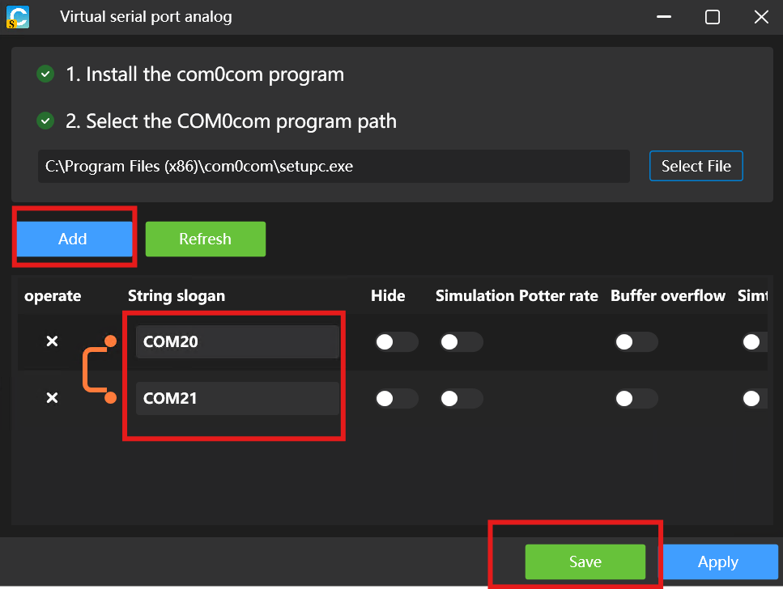
Before proceeding, please create the virtual serial port as instructed in the experiment PPT.

Slide 2
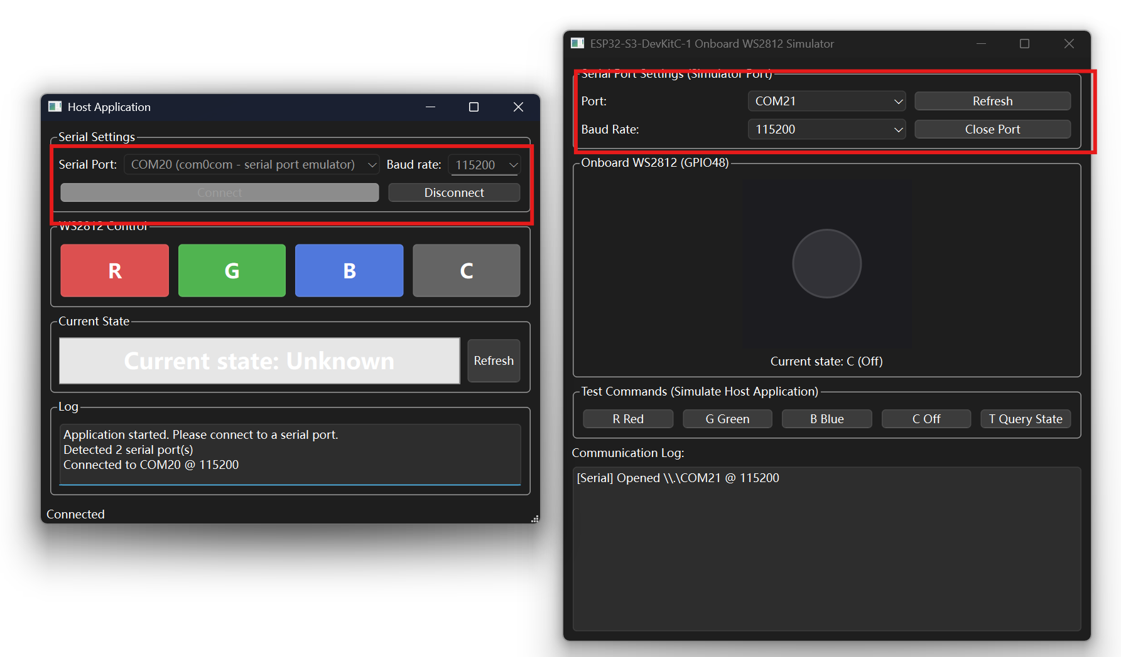
Launch the Host application and the Simulator, and connect them to the two serial ports of the virtual pair respectively.
Do NOT connect to the same port number!!!

Slide 3
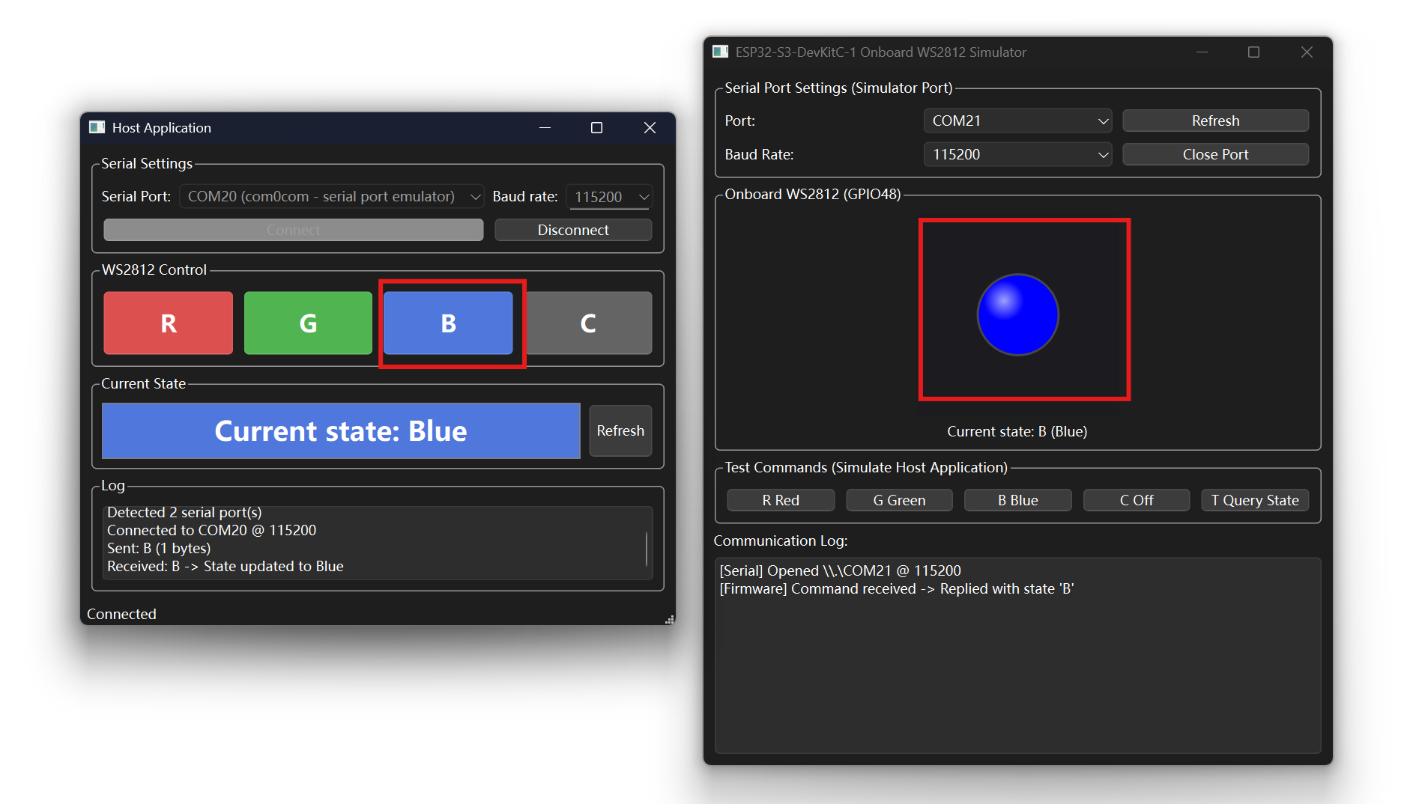
Interact with the Host application to observe the Simulator's response.

